Slide 1
Final Evaluation
DL & NLP pour le diagnostic
Romain Lhotte & Paul Dubois

Slide 2
Grade of this final evaluation
75% performance (it’s not a Kaggle, you have to send us tensors and we will run the evaluation pipeline ourselves at the end). C.f. the example submission notebook.
25% oral presentation on the 4th of March.
This project is 50% of your overall grade.
Teams of 4 max.

Slide 3
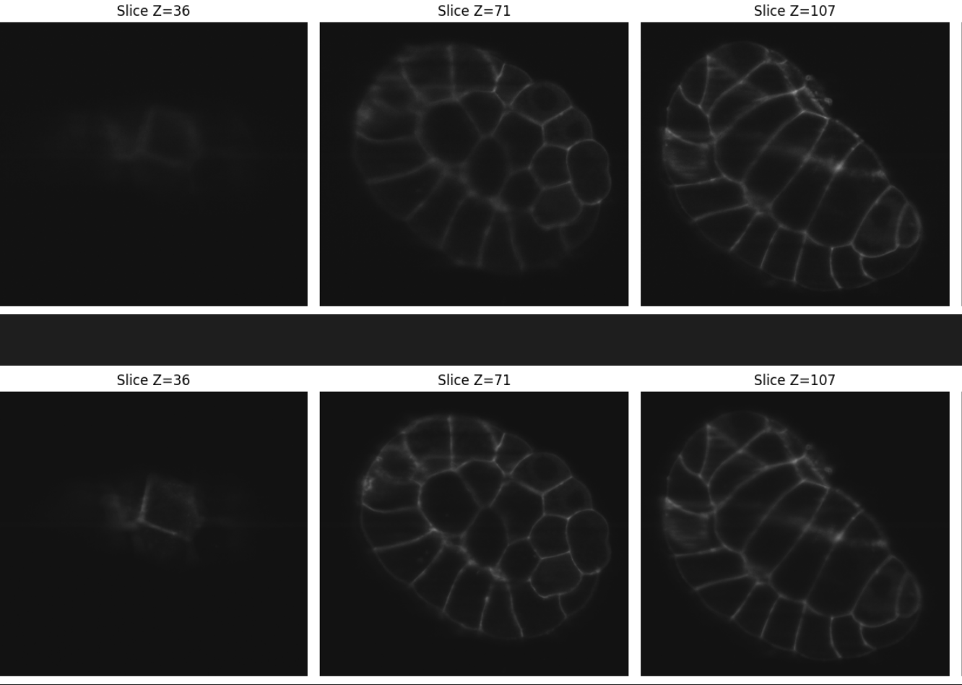
Context
3D images in microscopy are sometimes not of great resolution for multiple reasons.
We give you pairs of real microscopy images (low-resolution & high resolution). You must learn how to improve the resolution.
Figure1: Example of a data pair (only 3 slices are shown, the resolution difference is very visible on slice 1) of the training set (image_15_membrane_angle.tif)

Slide 4
Data
All images are 3D, represented with 3D array shapes (.tif format) in the ZYX format.
You can find them on the DCE at /mounts/Datasets4/DeepLearningVSE2025.
Run cd /mounts/Datasets4/DeepLearningVSE2025 to make sure everything is ok.
In this image-to-image task, you will work with pairs of images for the training task. The input images, referred to as "angles," correspond to the initial view, while the "fused" images serve as the ground truth.
In the test set you will only have the “angles” images (for now there is no test set accessible to you).

